Slide 1
Assignment scaffold
Year 11 Biology
Bremer SHS

Slide 2



Developing a research question
Draft: Does carbon dioxide affect the rate of photosynthesis in aquatic plants?
Refined: Does a set concentration of carbon dioxide affect the photosynthetic rate of Elodea spp.?
Final: Does a 2.0 mM concentration of carbon dioxide increase the photosynthetic rate of Elodea spp.?
When developing a research question:
Identify the practical that is being modified.
Identify the independent variable.
Identify the dependent variable.
Identify the methodology being used.
Draft a research question.
Refine and focus the research question so that it is more specific.
Criterion – Research and Planning

Slide 3

Writing a rationale
A rationale should outline what you have found out about a topic and how it inspired your research question.
Start broad and narrow in on specifics relating to your research question as you progress.
It should apply appropriate scientific concepts to your research question.
Relate to Topic 1: Cells as the Basis of Life of the Biology 2019 syllabus.
Criterion - Research and Planning
- Communication

Slide 4
example
Research Question
Does treatment with household grey water increase the biomass of Chlorella spp. in 168-hour fixed growth period?’
Rationale
Biomass is defined as the amount of living matter per unit area and can be used as a fuel to generate electricity (IUPAC 2006). With increasing concerns about fossil fuels as a finite resource, microalgae are being investigated as a potential source of renewable, biomass fuel. Their ability to rapidly sequester carbon and grow quickly makes them a potential sustainable alternative (Dismukes 2008).
Chlorella is a microalgae that has a fast growth rate (relative to other microalgae), is unicellular and lives in freshwater (Mohsen 2017). It is easy to cultivate, has a high chlorophyll content and contains oil that can be made into biodiesel (Chisti 2007). Like most plants microalgae are limited in growth by the presence of sunlight and water. They also require levels of nitrogen, phosphorus and potassium for optimum growth (Wen 2014).
Greywater comes from used water in a building that has not come into contact with faeces but cannot be stored for more than 24 hours (Qld Govt 2016). Instead greywater diversion devices can be installed diverting this resource into irrigation. Many laundry detergents and dishwashing powders contain phosphorus. Consequently, this consideration led to question could greywater be used to grow microalgae?

Slide 5
example
Research Question
Does treatment with household grey water increase the biomass of Chlorella spp. in 168-hour fixed growth period?’
Rationale
Biomass is defined as the amount of living matter per unit area and can be used as a fuel to generate electricity (IUPAC 2006). With increasing concerns about fossil fuels as a finite resource, microalgae are being investigated as a potential source of renewable, biomass fuel. Their ability to rapidly sequester carbon and grow quickly makes them a potential sustainable alternative (Dismukes 2008).
Chlorella is a microalgae that has a fast growth rate (relative to other microalgae), is unicellular and lives in freshwater (Mohsen 2017). It is easy to cultivate, has a high chlorophyll content and contains oil that can be made into biodiesel (Chisti 2007). Like most plants microalgae are limited in growth by the presence of sunlight and water. They also require levels of nitrogen, phosphorus and potassium for optimum growth (Wen 2014).
Greywater comes from used water in a building that has not come into contact with faeces but cannot be stored for more than 24 hours (Qld Govt 2016). Instead greywater diversion devices can be installed diverting this resource into irrigation. Many laundry detergents and dishwashing powders contain phosphorus. Consequently, this consideration led to question could greywater be used to grow microalgae?
Research and Planning
The rationale shows sound application of scientific concepts to the research question. However, the rationale does not discuss the transfer and transformation of solar energy, or the link between producing biomass and the interaction with carbon cycle components.
Communication
Acknowledgment of sources of information through appropriate use of referencing conventions.

Slide 6
methodology
This section is split in to two subheadings: Original experiment and Modifications to Methodology. It should:
Outline source that methodology has been adapted from and summarise the original experiment.
Outline any modifications to the original experiment.
Outline how the modified experiment will collect sufficient and relevant data.
Give sound reasons for how the modifications will refine, extend or redirect the original experiment.
Criterion - Research and Planning

Slide 7
example
Continued on next page…
Original experiment
The methodology used has been adapted from:
• SAPS, A-level set practicals – factors affecting the rates of photosynthesis http://www.saps.org.uk/secondary/teaching-resources/1354-a-level-set-practicals-factors-affecting-rates-of-photosynthesis
• BTI Curriculum Projects in Plant Biology, Algae to Energy, Teacher Manual 2015 btiscience.org/wp-content/uploads/2015/12/b.-Algae-to- Energy-Teacher-Manual-2015.pdf
The original SAPS experiment used algal balls (algae suspended in sodium alginate) with a hydrogen carbonate bioindicator to investigate rates of photosynthesis. The BTI experiment used a photobioreactor. This experiment draws from both experiments and combines the use of algal balls and photobioreactors. The control will be tap water.

Slide 8
Modifications to the methodology
To ensure that sufficient, relevant data was collected the original experiment was changed to increase the number of samples and measurements, as the original experiment had a small sample size. The reliability of the data collected was improved by making changes to the original methodology (see refinements) and validity of the experiment was improved by narrowing the research question to investigate one independent variable (see extensions). To minimise error all other variables were controlled as per the original experiment.
Refined by:
• using a ten-bottle photobioreactor (with a stone aerator connected to a pump), five bottles containing the control and five containing the treatment solution (see page 16 of Teacher manual) to address sources of sample bias. Each photobioreactor will have 10 algal balls. The mass of these will be measured every 24 hours (for the time period) using an electronic balance.
• five trials from each sample will be taken to ensure that there is sufficient data to calculate mean, standard error and establish a confidence interval.
Extended by:
• investigating greywater as a treatment, based on phosphorus being limiting factors of growth (Lohman 2014) to increase algal biomass (independent variable).

Slide 9
Modifications to the methodology
To ensure that sufficient, relevant data was collected the original experiment was changed to increase the number of samples and measurements, as the original experiment had a small sample size. The reliability of the data collected was improved by making changes to the original methodology (see refinements) and validity of the experiment was improved by narrowing the research question to investigate one independent variable (see extensions). To minimise error all other variables were controlled as per the original experiment.
Refined by:
• using a ten-bottle photobioreactor (with a stone aerator connected to a pump), five bottles containing the control and five containing the treatment solution (see page 16 of Teacher manual) to address sources of sample bias. Each photobioreactor will have 10 algal balls. The mass of these will be measured every 24 hours (for the time period) using an electronic balance.
• five trials from each sample will be taken to ensure that there is sufficient data to calculate mean, standard error and establish a confidence interval.
Extended by:
• investigating greywater as a treatment, based on phosphorus being limiting factors of growth (Lohman 2014) to increase algal biomass (independent variable).
Shows careful and deliberate thought about adequate collection of data so that an informed conclusion to research question can be made. .
Gives sound reasons for modifications will refine, extend or redirect the original experiment.

Slide 10


Safety and ethical considerations
Before completing the experiment, you were asked to complete a risk assessment. You will need to report on the considerations that you made in planning phases of the experiment.
Your report should include:
Identify the risks, ethical issues and environmental issues associated with experiment.
Outline how risks and issues will be managed during experiment
Criterion - Research and Planning

Slide 11
example
Safety and ethical considerations
• Adhere to safety considerations outlined in the original experiment.
• Review MSDS sheets in Risk Assess for using greywater, dispose of accordingly.
• Wash hands before and after using the photobioreactor to avoid contamination.

Slide 12
example
Safety and ethical considerations
• Adhere to safety considerations outlined in the original experiment.
• Review MSDS sheets in Risk Assess for using greywater, dispose of accordingly.
• Wash hands before and after using the photobioreactor to avoid contamination.
The response shows careful and deliberate identification and planning to handle risks and ethical or environmental issues in the experiment.

Slide 13
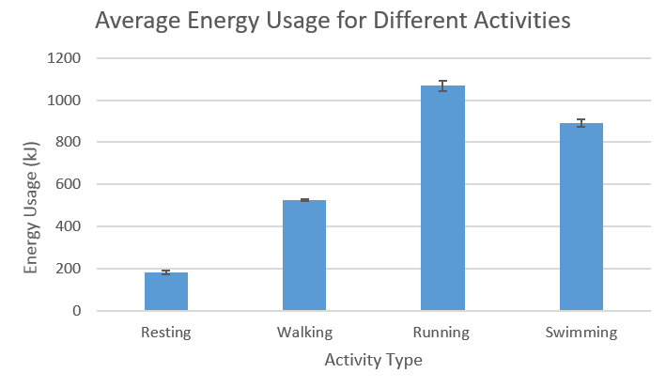
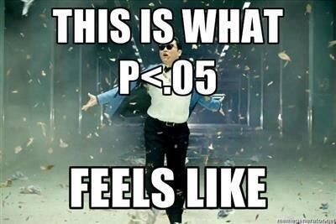
Processed data
This section should present the data collected in your experiment in appropriate forms. This may include:
Outline of calculations were completed
Sample calculations (eg. Mean, standard deviation, standard error)
Data tables and appropriate graphs
ANOVA test for multiple variables
Two-Sample Analysis (T-test) for two variables
You will need to write a statement about the data that you process. Each statement should include:
Interpretation of results – identify trends
Analysis of results – explanation of trend
Criterion – Analysis of Evidence
- Communication

Slide 14
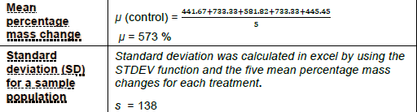
example
Table 1 – Sample Calculations
Analysis if Evidence
Correct and relevant processing of data.

Slide 15
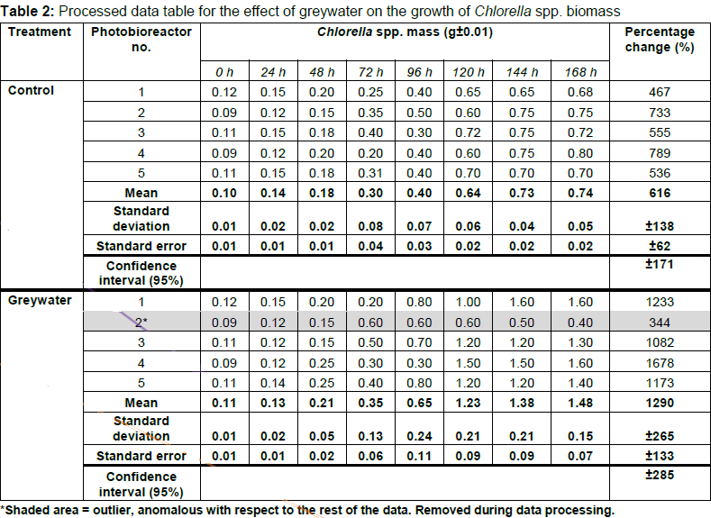
Analysis if Evidence Collects sufficient and relevant raw data.
Communication
Appropriate use of representations and genre (eg. correct units, same significant figures)
Analysis if Evidence Identification of relevant trend.
Analysis if Evidence
Identification of limitations of evidence.
Interpretation and Analysis:
The data shows the mean percentage biomass change of the control treatment was within the range of 616 ± 62.0% whilst the greywater treatment was 1290 ± 133%.The standard error has been used as a measure of the uncertainty associated with these averages (±SE). The larger standard error of the greywater treatment data may suggest low precision during data collection or high random biological variation in the samples.

Slide 16
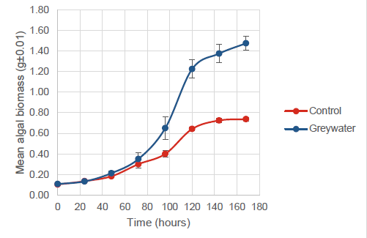
Communication
Appropriate use of scientific language and representations.
Analysis if Evidence
Identification of relevant trend.
Analysis if Evidence
Identification of limitations of evidence.
Figure 1: Mean algal biomass change over a 168-hour period for control and greywater treatment (error bars represented by standard error).
Interpretation and Analysis:
The literature suggests that the algal population growth should pass through four stages (lag, exponential, transitional and stationary). This data fits this model for both treatments, suggesting both samples grew in the expected pattern. The greywater data shows an increased exponential growth phase (48 – 120h) compared to the control treatment.
The stationary growth phase (120 – 168h) occurs at a higher final mean biomass in the greywater data. This suggests that the greywater treatment has a positive effect on algal growth.
The standard error of the data shown suggests that the data collected for the control treatment has a higher level of precision than that of the greywater treatment.

Slide 17
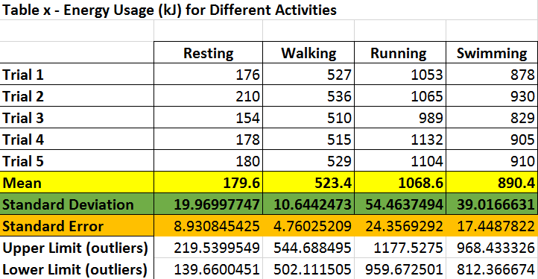
Your turn…
Write an interpretation and analysis for the table.
Interpretation and Analysis:
The mean shows that ….
The mean suggests that…..
The standard deviation was calculated because….
The standard deviation shows….
The standard deviations suggests that….
The standard error was calculated because….
The standard error shows….
The standard error suggests that….

Slide 18
Your turn…
Write an interpretation and analysis for the table.
Table z – ANOVA results
Variation between groups | P = 0.0000000000008
Interpretation and Analysis:
An ANOVA was used to….
The data shows that….
A P-value less that 0.05 suggests that…
The limitation to using an ANOVA is…..

Slide 19
Your turn…
Table y –Two-Sample Analysis Results
Write an interpretation and analysis for the table!
Variables Compared | P- Value
Resting and Walking | 0.0000000006
Resting and Running | 0.0000000002
Resting and Swimming | 0.0000000003
Interpretation and Analysis:
The t-tests were used to ….
The data shows that….
A P-value less that 0.05 suggests that…

Slide 20

evaluation
The evaluation of your methodology and suggested improvements should be arranged under the following headings.
Limitations of the evidence
Sources of error effecting reliability
Sources of error effecting validity
Suggested improvements and extensions
Criterion
Analysis of Evidence
Interpretation and Evaluation

Slide 21
details for each subheading
Each of the subheadings should include the following information:
Limitations of the evidence
Outlines limitations to data
Sources of error effecting reliability
Explanation of why the experiment does not produce consistent outcomes
Sources of error effecting validity
Explanation of why the experiment does not measure the most appropriate data
Suggested improvements and extensions
Explanation of ways to improve the experiment in order to address sources of error affecting validity and reliability
Suggests ways to increase the breath or scope of the investigation

Slide 22
example
Analysis of Evidence
Thorough and appropriate identifcation of the uncertainty and limitations of evidence.
Evaluation
Limitations of the evidence
Standard error, overlapping error bars and confidence intervals are all examples of the uncertainty and limitations observed from an analysis of the evidence. This can be explained by a lack of reliability and validity in the experimental process.
The masses recorded for the algal biomasses were inconsistent (refer to Table 1, see standard deviation) hence the average percentage change is calculated from data that lacks some reliability, as indicated by the standard error. This suggests that not all variables were fully controlled. Also, the standard error of the greywater treatment data was higher than the control treatment (refer to Figure 2) which may suggest low precision in the measuring instrument or high random biological variation in the samples.
The low sample size of this experiment is a major factor in determining the length of the confidence intervals (refer to Figure 2). Consequently, the evidence is limited in its ability to be used to extrapolate the findings of the experiment to the population of Chlorella spp.
An outlier (for the greywater treatment) was identified. However, this was not confirmed as a valid extreme value through experimentation; consequently, the mean reported may have altered the results of the data analysis.

Slide 23
Sources of error effecting reliability
• The electronic balance used to measure the mass of Chlorella spp.is imprecise (±0.01g). Therefore, the electronic balance contributes to the imprecision of the data. However, the variation in the data is greater than ±0.01g; therefore, there must be other sources of imprecision.
• The samples were not randomly selected and the strain of Chlorella spp. was not genetically screened. Random biological variation exists within the sample. This could explain some of the remaining imprecision in the data.
• The composition of the greywater was not determined prior to conducting the experiment. Therefore, it is not known which abiotic and biotic factors are affecting the growth of the Chlorella spp.
Sources of error effecting validity
• The sodium alginate leads to a wet rather than dry biomass reading. Therefore, the mass of the data is overestimated. In addition, the algal biomass is determined indirectly which could lead to greater variability in the data.
• The electronic balance does not count algae cells directly. The equipment used is not the most appropriate to collect data. Therefore, this could contribute to the data being inaccurate.
Interpretation and Evaluation
Justified discussion of the reliability and validity of the results.

Slide 24
Suggested improvements
Reducing the random error in the experimental process would improve its reliability. In this experiment, the reliability of the data could be improved by increasing the number of repeat readings of each sample, increasing the number of samples and running the experiment (trial) more than once to decrease standard error.
To address the imprecision in the data a random sample selection technique should be used which would reduce selection bias. This could improve both the reliability of data and validity of the experimental process and allow the results to be generalised to the population. In addition, assessing the composition of the greywater prior to conducting the experiment or use water with a known nutrient concentration would allow the research parameters to be refined.
Instead of using an electronic balance, the accuracy of the algal biomass data could be improved by using a colorimeter to quantify the density of cells, or a hemocytometer to count algal cells directly. To reduce the systematic error introduced from the mass of the sodium alginate balls a dry biomass reading would measure the algal biomass directly. This would improve the validity of the experiment.
Suggested extensions
• Redirect the experiment by choosing specific chemical treatments found within the composition of the greywater.
• Extend the experiment by investigating an optimum concentration of greywater, varying the technique of applying the greywater
Interpretation and Evaluation
Suggests improvements and extensions which are derived from analysis.

Slide 25

conclusion
The conclusion should use sound evidence and reasons to respond to the research question.
This section should also include a word count.

Slide 26
example
In conclusion, the evidence suggests that treatment with household greywater does increase the biomass of Chlorella spp. in a 168-hour fixed growth period. However, there are significant limitations to the experimental design and further statistical analysis would be required to support this conclusion.
Word count: 1660
Interpretation and Evaluation
Conclusion directly responds to the research question.

